Slide 1
Weekly Updates
sdmay25-11

Slide 2
Our Week of Testing/Errors
Our First Test
Our Solutions
In the future
We encountered several errors testing the linkage between the Flutter frontend and the C++ backend
Debugging on-site suggested further development was needed
Lowering the latency of the backend calls is necessary.
Modifications were made to reduce the load and increase parallelism.
Further work on integrating iPhone’s ML Core can increase computing power.
Additional latency modifications can be made.

Slide 3
But wait… there is good news!!
We have successfully installed OpenCV’s total library for Android
Partitioning a Linux container, we installed:
Google web commands to install
Android SDK & NDK
Ninja
CMake
OpenCV’s repo
OpenCV’s contrib_modules repo
After a successful 2 hour build, we have a successful integration with the current C++ code for both iOS and Android building and running.

Slide 4
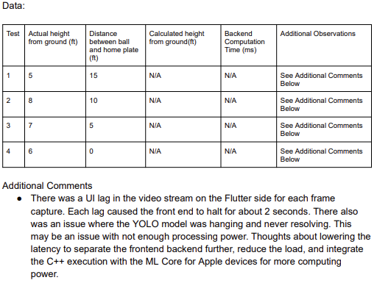
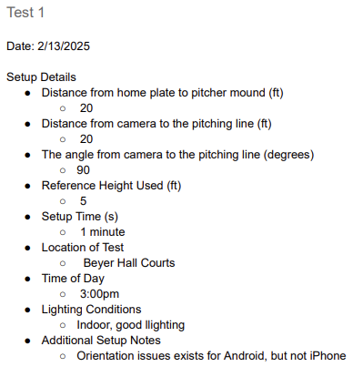
Our First Test

Slide 5
Our Latency Solutions Branch: lower-latency
01
C++ Multithreading
Flutter UI Lagging
02
Edit the OpenCV program to use the maximum number of CPUs available
All of OpenCV’s intensive calls like KCF support parallel execution on multiple CPUs.
Will increase efficiency of these major function calls, lowering latency.
Flutter Isolates are a tool that allows you to execute a function on an alternative Flutter thread.
Change the image stream to execute on another Flutter thread, calling the C++.
This allows the frontend display to run as normal, and update when results return.
03
Reducing Frames
Flutter runs with 120 fps on supported devices.
We were attempting to capture and send 120 frames to the C++ functions.
Reduced to capturing 1 every 4 frames, reducing the load and improving latency.

Slide 6
Core ML
Documentation: https://developer.apple.com/documentation/coreml/
Why this could be useful for us:
Allows us to leverage the iPhone’s Neural Engine, which is dedicated for machine learning
Present on iPhone 8 and later
Would give us a way to separate and optimize the YOLO model for better performance

Slide 7
Additional Latency Solution
Image Pointer Management
Currently there exists multiple copying of memory files to pipe the image to the backend.
CameraController(img) → Isolate(img) → OpenCV Handler(img) → C++(img)
Our goal next week is to minimize the image copying by using a pointer of the memory location of the image.
The image is stored within the cache of the device.
This requires a rewrite of the C++ code, Isolate, OpenCVHandler, and CameraController.
CameraController(img) → Isolate(img_ptr) → OpenCV Handler(img_ptr) → C++(img_ptr) → C++(img)
Makes one copy instead of 3, reducing the load of image frame transfer by 3.
Can also fix additional OpenCV image distortion issues when pulling directly from memory.

